Slide 1
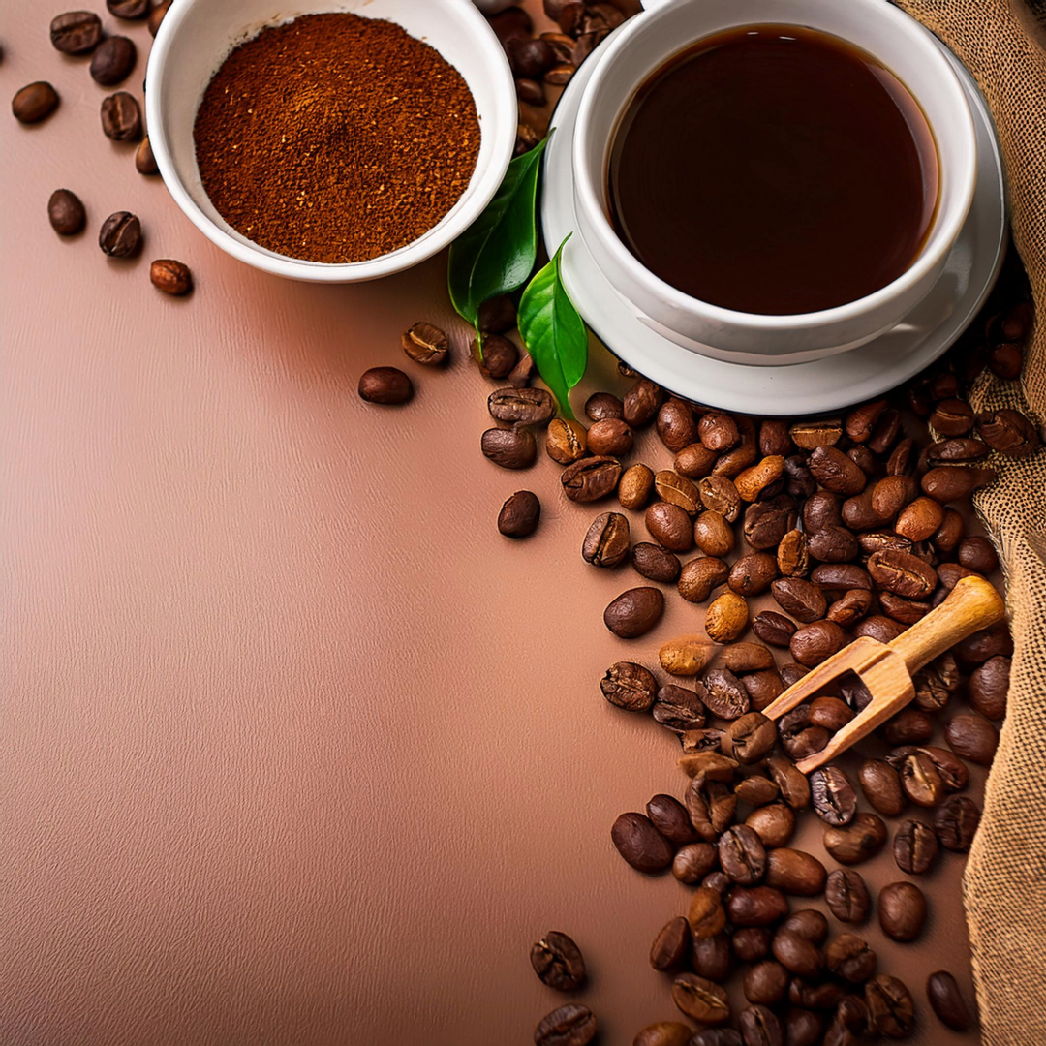
RAÍCES
Smart Artificial Intelligence

Slide 2

Herramientas usadas
Data: dataset de Federación Nacional de cafeteros de Colombia, MongoDB,
Mockup: Figma
Video: Davinchi Resolve
Framework backend: streamlit (python)
Framework Frontend react: Remix (framework) - ethereum (javascript)
Arquitectura en la nube: AWS

Slide 3
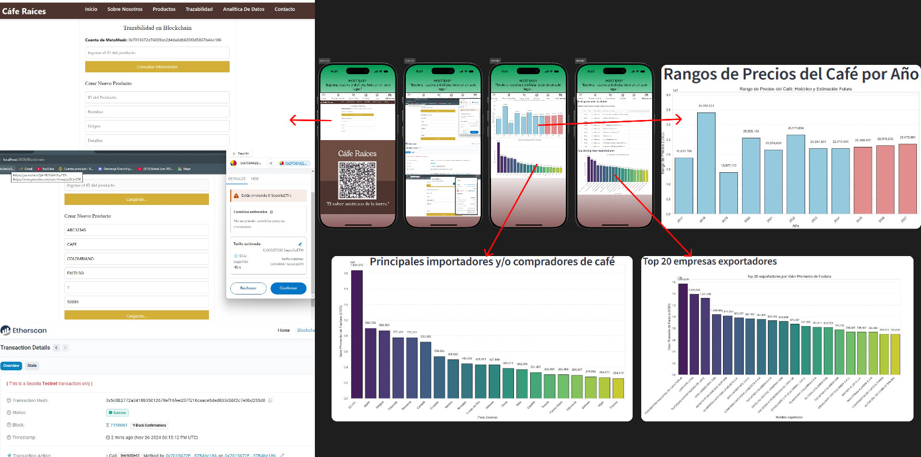
Mockup

Slide 4
Mockup
AWS, BLOCKCHAIN E INTELIGENCIA ARTIFICIAL

Slide 5
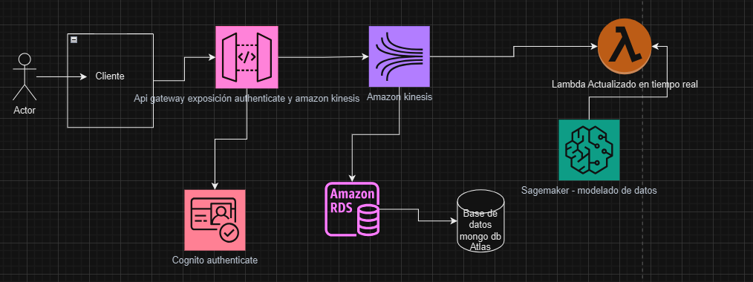
https://github.com/Diego8223/agrotech-frontend

Slide 6

Video

Slide 7
Mockup
GRACIAS

